Slide 1
MEEM 5990 Autonomous control of a Hexacopter using Pixhawk and Beaglebone Black
Presented By
Mugesh
Project Guide: Dr.Nina MAHMOudian

Slide 2
Outline
Introduction
Current Trends & Applications
Hardware Used
System Overview
Off board control
Mavlink Protocol !!
Read/Write a Mavlink Message !!
Sequence of steps
Future Prospects
Conclusion

Slide 3
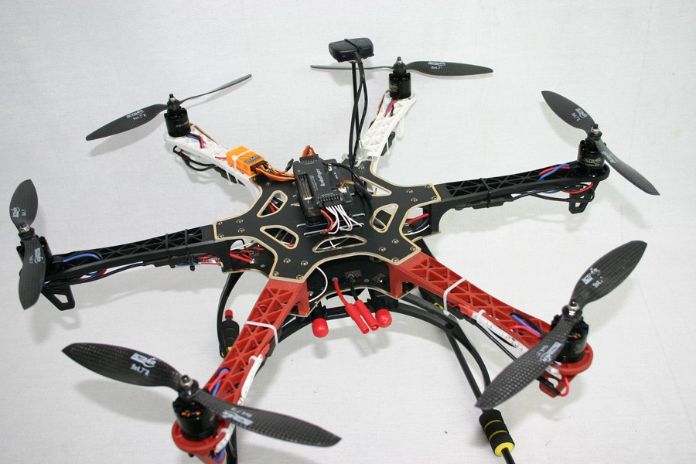
Introduction
Unmanned Aerial Vehicle (UAV) / Micro Air Vehicle (MAV)
What is an Hexacopter ??

Slide 4
OBJECTIVE
The main purpose is to autonomously navigate a Hexacopter using a Flight controller
The flight controller is controlled externally using a companion computer
This provides great flexibility to do complex computation which cannot be done with the flight controller in a powerful computer and send commands to the flight controller

Slide 5
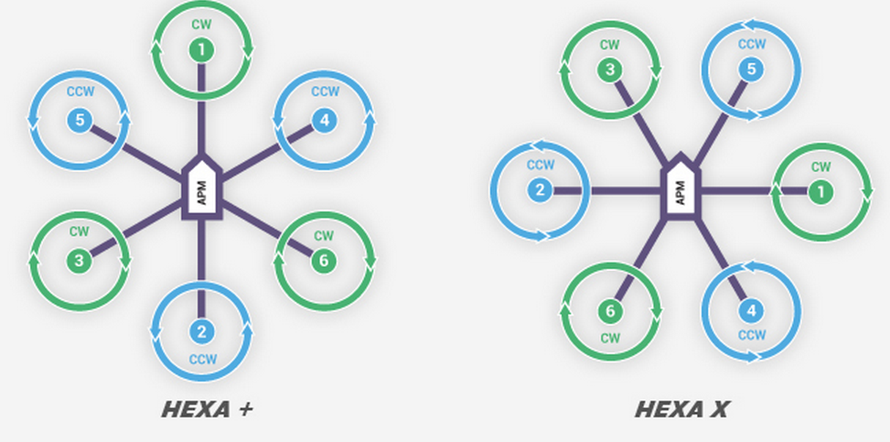
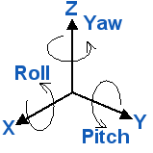
Principle of Operation
ROLL – Rotation of UAV about X-axis
PITCH – Rotation about Y-axis
YAW – Rotation about Z-axis
THRUST – Lift force produced by rotation of all motors at same speed
Notes:
----- Meeting Notes (4/13/15 21:17) -----
type E is chromel vs constantan
type k is chromel vs aluminum
type s is platnun vs 10% rhodium

Slide 6
Current Research Trends & Applications
Vision aided navigation and control
Active environmental perception, obstacle avoidance, and agile low altitude flight
Navigation and estimation theory and sensor fusion
Sector | Applications
Military / Security | 1.Defense surveillance
Science | 1. Wireless Communications 2. Autonomous navigation and control
Civil / Environment | 1. Disaster surveillance and management 2. Precision Agriculture

Slide 7
Hardware Overview
COMPONENT | SPECIFICATION
Hexacopter Frame | DJI Flamewheel F550 ARF KIT
Electronic Speed Controller | 15 A OPTO E300 Propulsion system
Motors | DJI 920 KV Motors (3 CW, 3 CCW)
Flight Controller | PIXHAWK PX4 Autopilot system
Companion Computer | Beaglebone Black
GPS | Ublox-Neo 7M GPS
Serial communication | UART – FTDI
Battery | 3 S - Lipo

Slide 8
PIXHAWK – OPEN SOURCE MAGIC !!

Slide 9
ON BOARD SENSORS AND GPS
ST Micro L3GD20H 16 bit gyroscope
ST Micro LSM303D 14 bit accelerometer and magnetometer
MEAS MS5611 barometer
Ublox NEO 7M GPS (external GPS)

Slide 10
Flashing Firmware and Sensor Calibration
PX4 Flight stack is an open source software for the autopilot
It can be flashed into Pixhawk using QGroundControl which is a Ground Station control software
After flashing firmware, the sensors need to be calibrated using QGC.
Compass, Gyroscope and Accelerometer

Slide 11
BEAGLEBONE BLACK
Powerful Linux computer with ARM cortex A8 Processor
Boots Linux under 5 seconds
Serves as a companion computer in this project to stream set-points to Pixhawk in Offboard Mode to follow
Reads all the sensor data from the Pixhawk and sends commands to pixhawk
Can be used to do complex path tracking algorithm like Kalman Filter, SLAM etc
Communicates serially with Pixhawk using UART interface

Slide 12
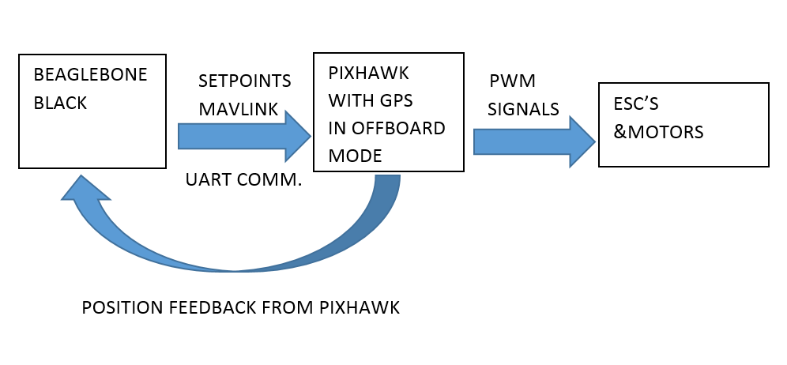
SYSTEM OVERVIEW

Slide 13
OFF-BOARD CONTROL OF PIXHAWK
Offboard control is the ability to control a PX4 based MAV using off-board software in a companion computer
The communication between the Pixhawk and BBB is done using the Mavlink protocol
Offboard commands are sent to PX4 in the form of setpoints for the controllers to follow (position, attitude, velocity or acceleration)
All these commands are done using Mavlink Messages

Slide 14
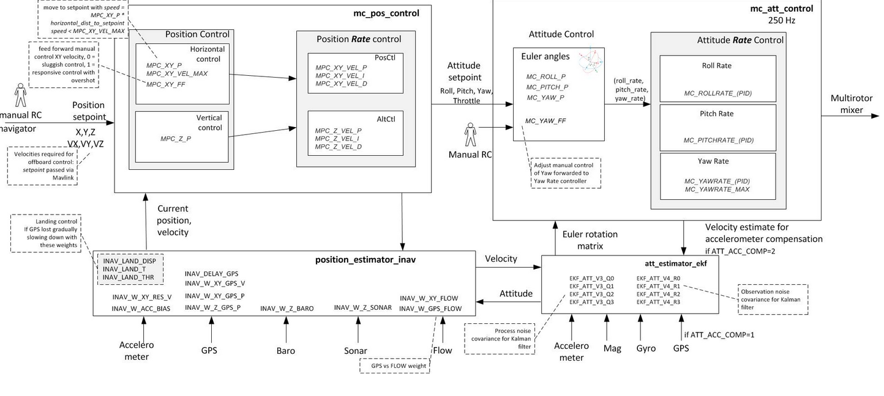
POSITION AND ATTITUDE CONTROLLER

Slide 15
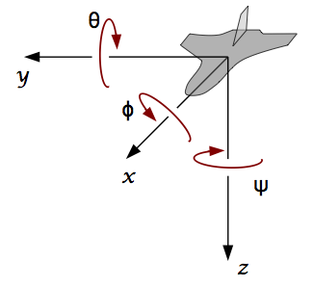
LOCAL BODY NED FRAME
Pixhawk works in a NED (North-East-Down) co-ordinate system.
I. The x axis points towards the north pole.
II. The y axis points to the east
III. The z axis points downwards to the center of the earth
The origin for this frame is set once upon boot and at first instance of GPS data
The transformation from Inertial frame to Body frame is done by the power of Pixhawk

Slide 16
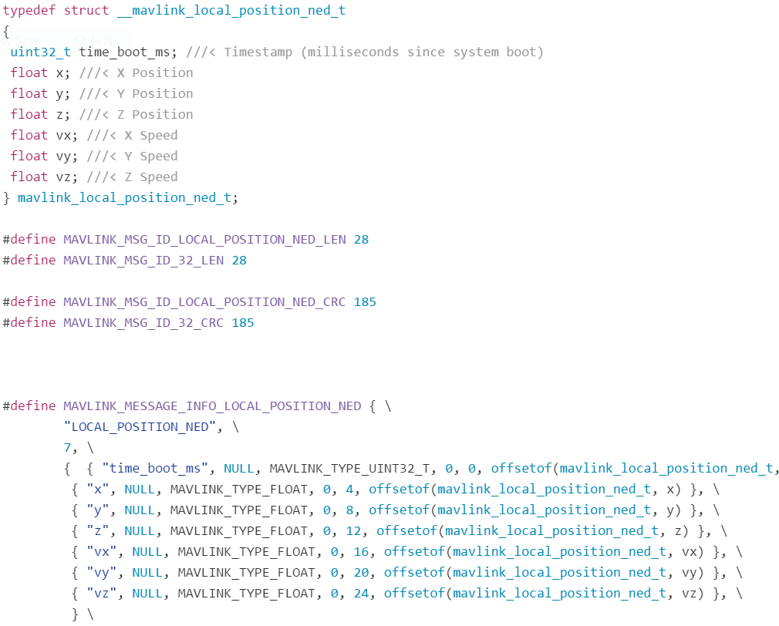
MAVLINK PROTOCOL !!
MAVLink is a very lightweight, header-only message marshalling library for micro air vehicles.
It can pack C-structs over serial channels with high efficiency
It was first developed by Lorenz Meier in 2009

Slide 17
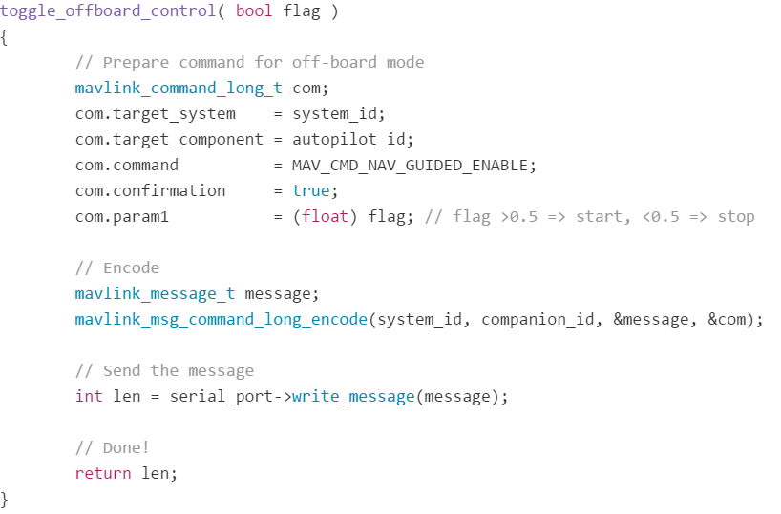
How to send a Mavlink Msg?
First step is to understand what the command going to do? For eg. MAV_CMD_NAV_GUIDED_ENABLE
What are the parameters needed for the command? – Set them
Encode into a message of struct mavlink_message_t !!
Write the message to the serial port!! DONE !!

Slide 18
Sequence of Steps
Set up serial comm. Between Pixhawk & BBB
The read/write software is developed by the PX4 developers !
Once all these things are done, following things can be achieved through Mavlink commands!
Start Mavlink application in Pixhawk by screening into Nuttx shell
Enable offboard mode
Disable Prearm check feature
Arm the hex
Start streaming set points

Slide 19
STARTING MAVLINK
The command to start application is
Nsh > mavlink start –d /dev/ttyS2
Once the application is started, many data are streamed by default like:
Heartbeat
Battery status
Local Position NED
Global Position INT
Servo output Raw
Camera Capture

Slide 20
Disabling Pre-Arm check
It is a safety feature added in the flight stack
It checks for RC control, GPS lock, Compass health by default and prevent arming before all seems OK!
Can be disabled by setting the parameter ARMING_CHECK to zero
Can be done using Mission Planner

Slide 21
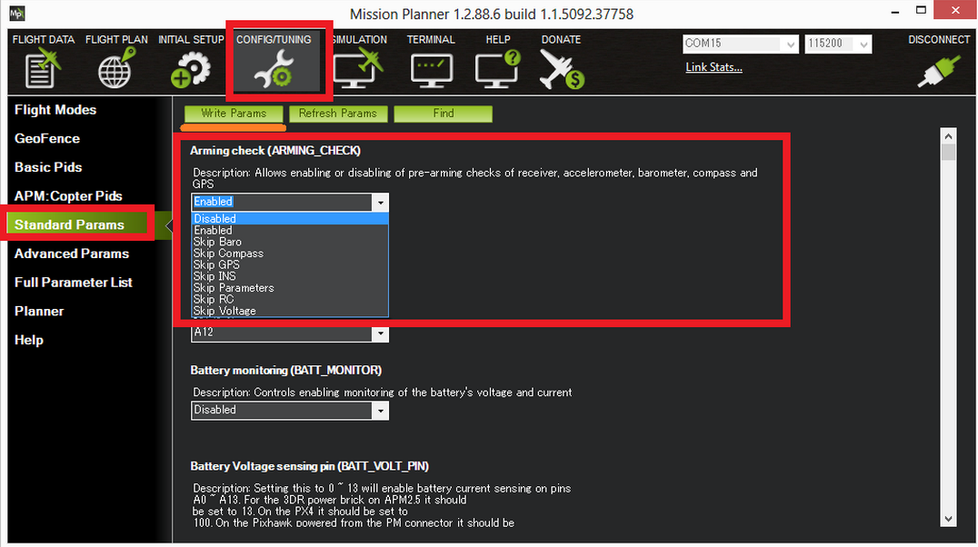

Slide 22
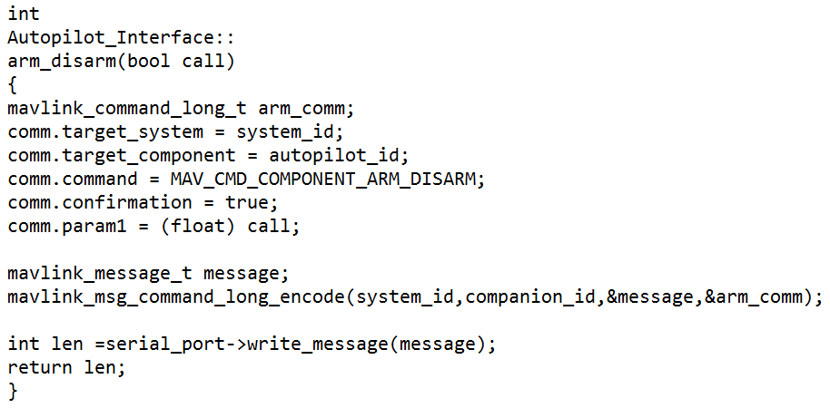
ARMING/DISARMING
Mavlink command : MAV_CMD_COMPONENT_ARM_DISARM
Param 1 = 1 (ARMING)
Param 1 = 0 (DISARMING)

Slide 23
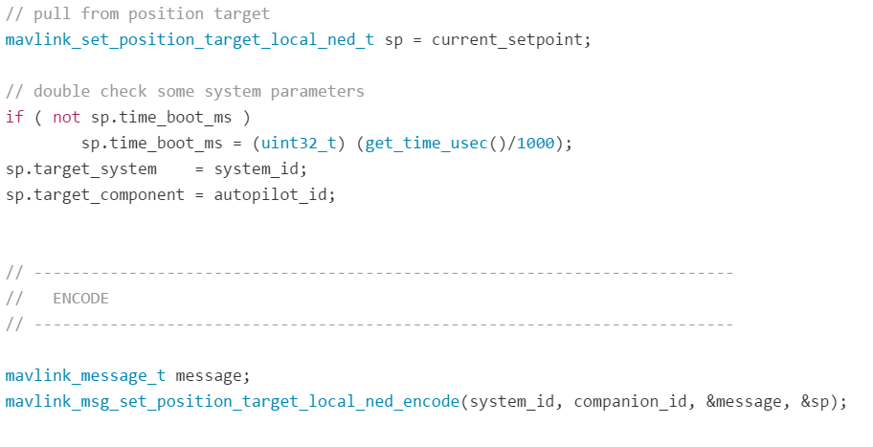
STREAM SET POINTS
Read the initial position by decoding the Local_NED_Position message
mavlink_msg_local_position_ned_decode(&message, &(current_messages.local_position_ned))
Set the target position we want to go in Local_NED_frame.
Update the target position and write the target position using the command
Once target setpoint is obtained, pixhawk will move to that position

Slide 24
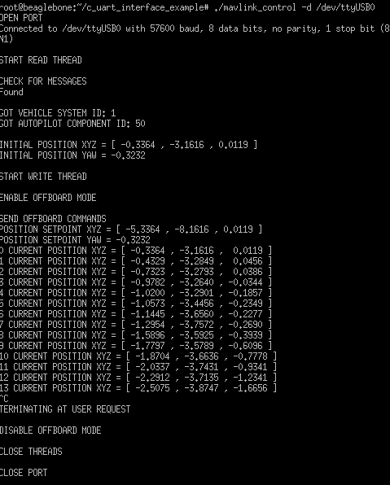
EXAMPLE OUTPUT

Slide 25
FUTURE PROSPECTS
This project is just a start!
Use Motion capture system in Lab to provide position of the Hexacopter and stream setpoints to Pixhawk accordingly
Track the hexacopter’s motion in 3D geometry
Use sonars to avoid collision using collision avoidance algorithm like ‘Quad Trees’ and do those computation in companion computer and send commands to Pixhawk to follow

Slide 26
CONCLUSION
As this project uses GPS, it is restricted to OUTDOOR applications
The purpose is to learn more about OFFBOARD control of PIXHAWK with any companion computer like BBB
Importance of MAVLINK Protocol
OFFBOARD control is dangerous. The velocity with which the hex is going to move cannot be controlled as of now
Always it is safe to use RC Control as back up and switch back to manual control if it goes beyond control
Extreme caution has to be taken before doing offboard control
Complex Path planning can be done using companion computer which cannot be done by flight controller

